Slide 1
Social-Media
Presented By :
Ganesh Gagare (250845920022)
Prajakta Palaskar (250845920051)
Shashank Mankar (250845920082)
Pradnya Shinde (250845920084)
Suhani Kasliwal (250845920094)

Slide 2
Aim
To connect people by allowing them to share photos and videos, express their ideas, stay entertained, and communicate easily, while also helping businesses and individuals reach a wider audience.

Slide 3
CONTENTS
Sr.no | Title
1) | Project Overview
2) | Problem Statement
3) | Goals and Objectives
4) | Proposed Solution
5) | Key Modules
6) | System Architecture with UML Diagram
7) | Software Requirement Specification
8) | Scope and Conclusion

Slide 4
Project Overview
A web-based social media application for online communication and interaction
Allows users to create profiles and connect with other users
Users can share posts, images, and updates
Supports likes, comments, and follow features
Provides secure authentication and data privacy
Designed to be user-friendly, scalable, and efficient

Slide 5
Problem Statement
Current social media platforms are complex, resource-heavy, and difficult to customize for specific user communities
There is a lack of lightweight systems that provide fast content sharing with real-time interaction
Managing user authentication, authorization, and session security is a major technical challenge
Handling large volumes of user-generated content while maintaining performance and scalability is difficult
Hence, there is a need to develop a modular, secure, and scalable social media application using modern web technologies that ensures smooth user interaction and efficient data management

Slide 6
Goal and objectives
To create a secure and efficient social media platform for digital interaction
To design a scalable system that performs well with increasing users
To provide a simple and intuitive user experience
To implement user registration, login, and profile management
To enable posting, liking, commenting, and following features
To ensure secure authentication and data privacy
To develop a modular backend for easy maintenance and enhancement
To store and manage user and post data efficiently using a database

Slide 7
Proposed Solution
User Authentication & Profile Management
User registration and login with secure authentication
Create and edit personal profiles (profile photo, bio, username)
Password encryption and session management
Media Upload & Management
Upload photos
Apply basic filters and captions
Store media securely in cloud/server storage
Feed & Content Display
Personalized feed showing posts from followed users
Social Interaction
Like, comment, and share posts
Follow and unfollow users
View followers and following lists
Stories & Temporary Content
Upload stories visible for 24 hours
Auto-delete stories after expiration

Slide 8
Key Modules
User Authentication Module
  Handles user registration, login, logout, and password security
User Profile Module
  Manages user profile creation, updates, and profile viewing
Post Management Module
  Allows users to create, edit, delete, and view posts (text/images)
Interaction Module
  Manages likes, comments, shares, and follow/unfollow features
Search Module
  Enables searching users and posts efficiently
Database Management Module
  Stores and retrieves user data, posts, and interactions securely

Slide 9
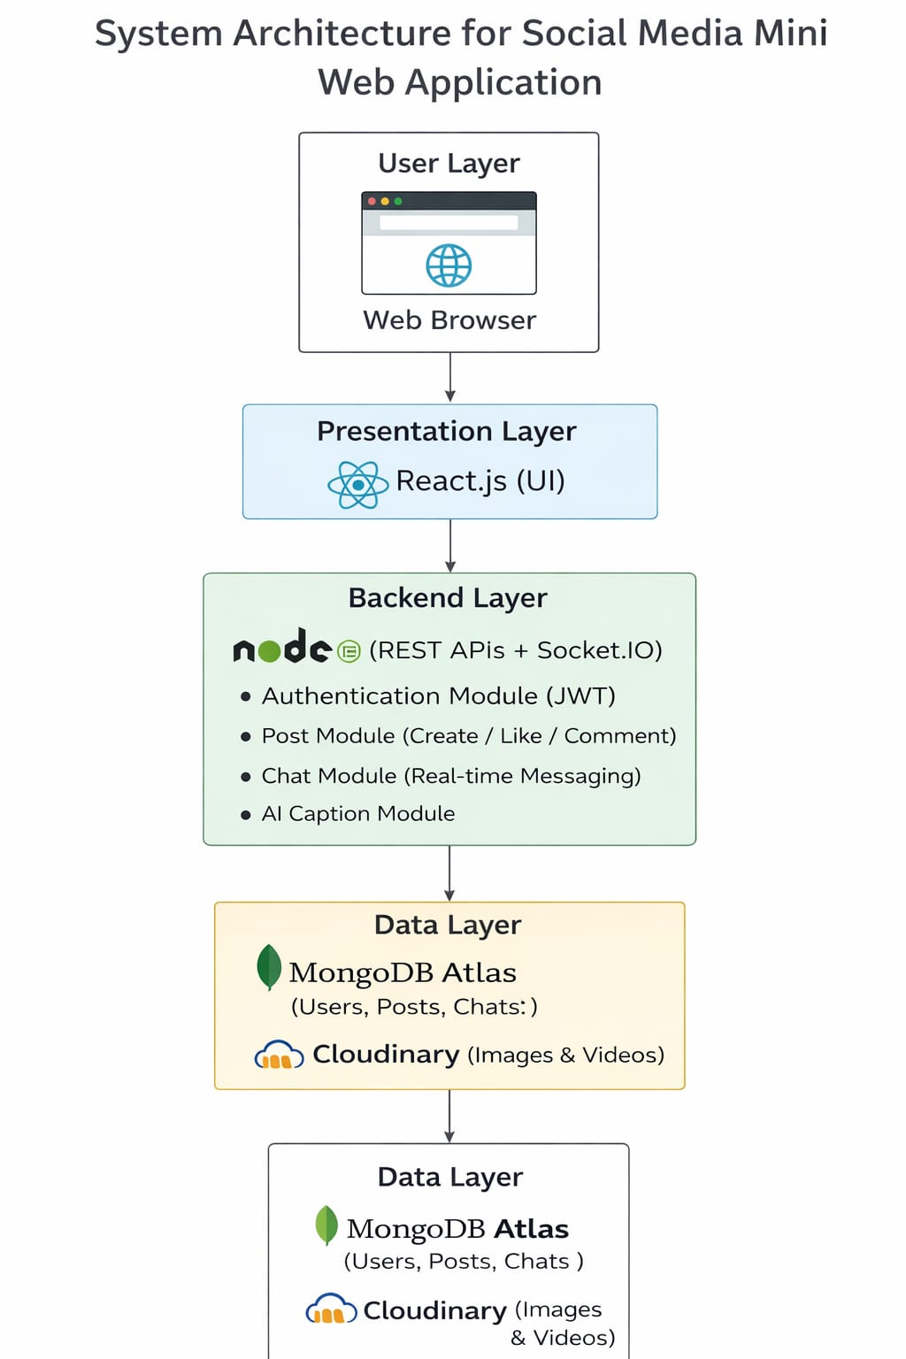
  System Architecture

Slide 10
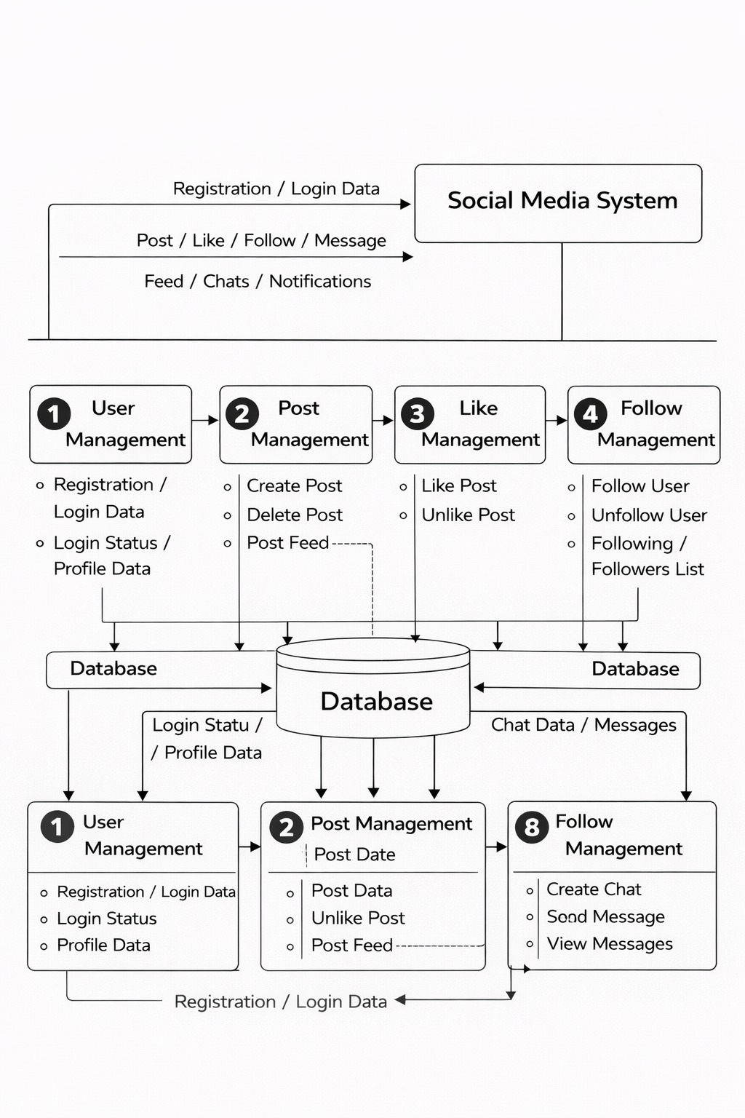
  DFD (Data Flow Diagram)

Slide 11
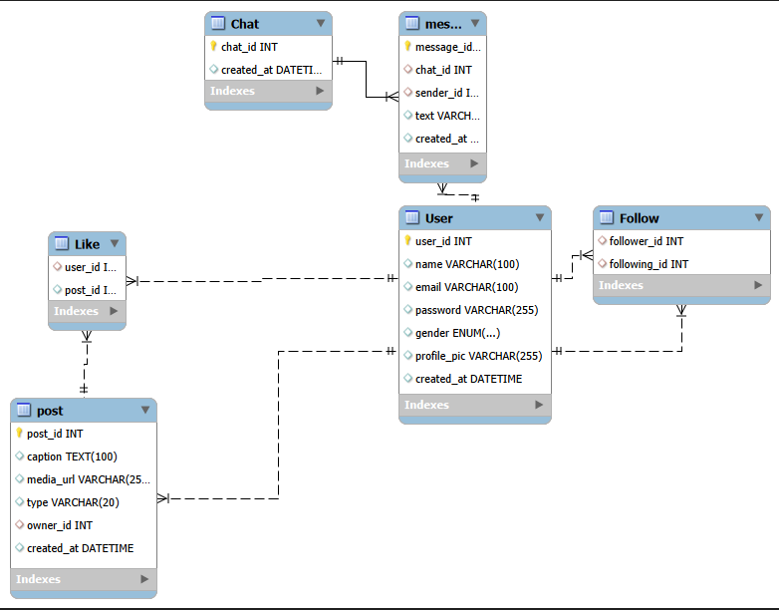
  ERD (Entity Relationship Diagram)

Slide 12
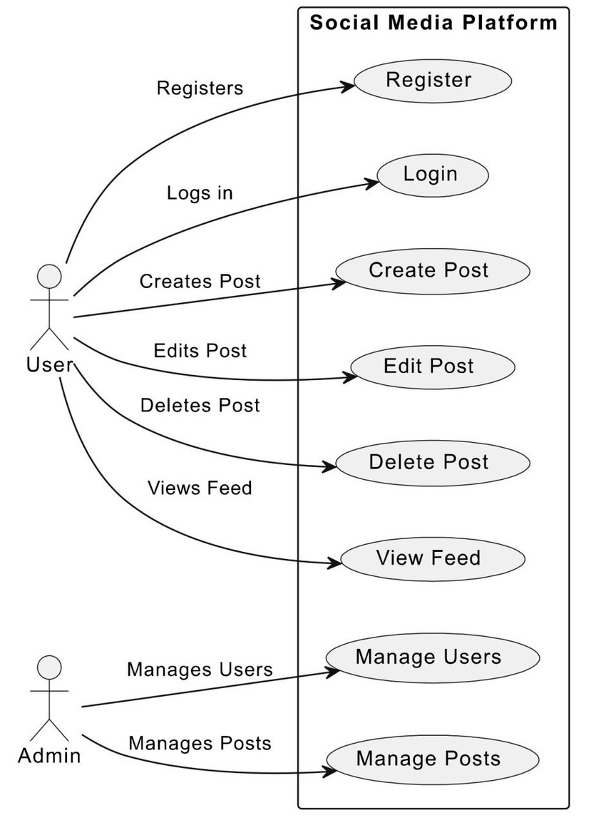
Use Cases Diagram

Slide 13
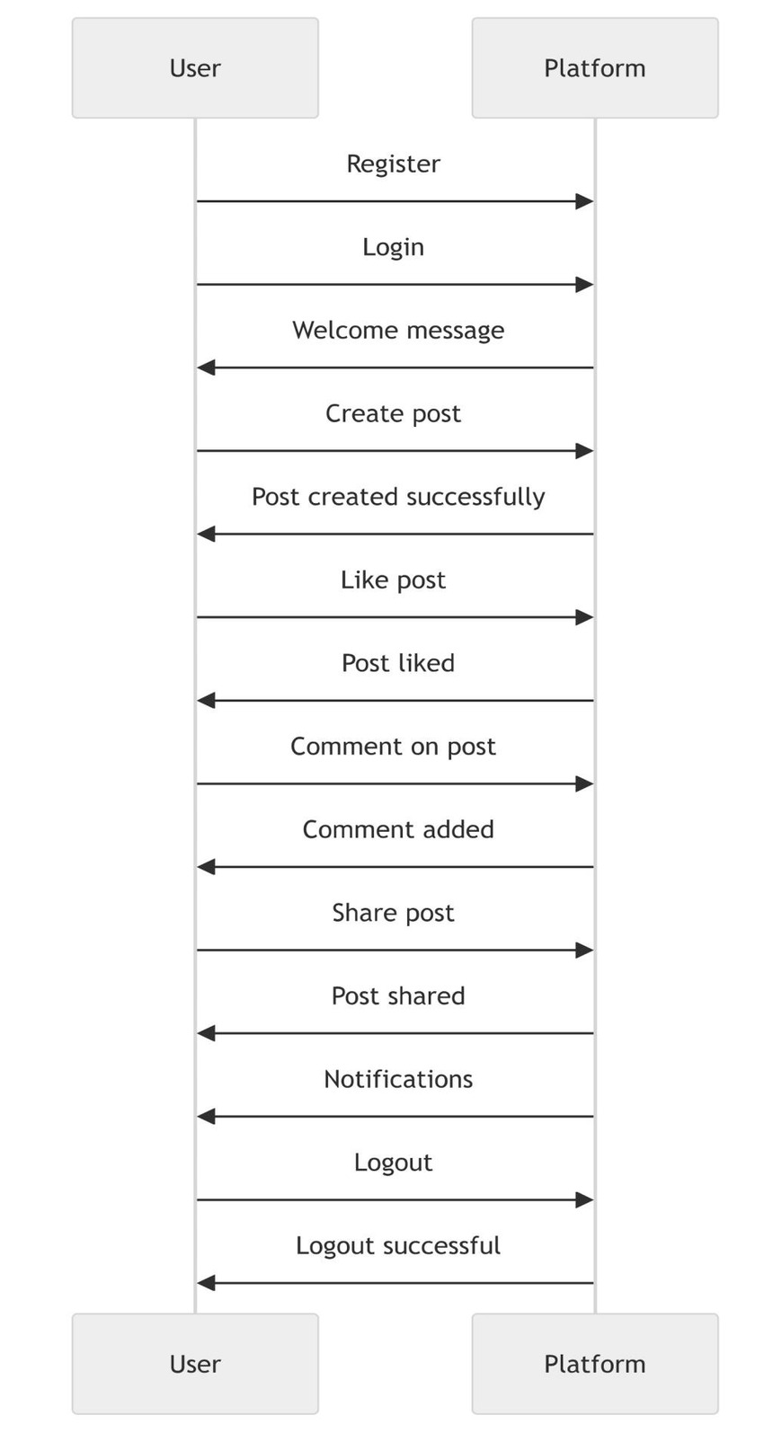
  Sequence Diagram

Slide 14
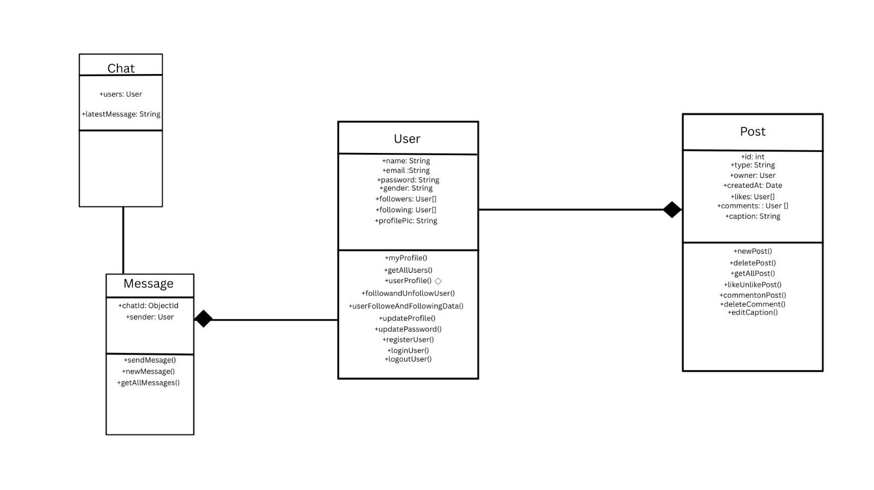
  Class Diagram

Slide 15
Software Requirements Specification
Hardware Requirements
Processor: Intel i3 or above
RAM: Minimum 4 GB
Storage: 100GB HDD or SSD
Software Requirements
Operating System: Windows 10 or Later
Frontend: HTML, CSS, Javascript, React.js
Backend: ASP.NET Core ,Express.js
Database: MongoDB
Server: IIS Server/Node.js Server
IDE: Visual Studio, VS Code

Slide 16
Scope And Conclusion
Development of a web-based social media platform
User registration, authentication, and profile management
Content sharing through posts, likes, and comments
Secure storage and management of user and post data
The project successfully provides a secure and interactive social media platform
The system is designed with a modular and scalable architecture
Data security and user privacy are effectively maintained

Slide 17
Thank You

